Slide 1
House Price Prediction
Presented by: Christoph Rendel
Elizabeth Shogbanmu
April 2022

Slide 2
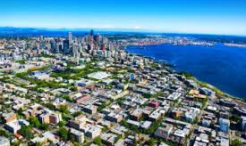
King County, Washington
Population- 2,269,675(Census 2020)-Most populated in Washington
Area-2,307 sq miles
490 square km water bodies
Highest Mountain- Mount Daniel 2,426m

Slide 3
Table of Contents
Introduction -Research Question
-Objective of Study
Data set
Data Processing Pipeline
Insights/Findings
Conclusion
Outlook

Slide 4
RESEARCH QUESTION/OBJECTIVE
DATA SET
The data set contains records of 21,597 houses sold in King County and 21 features
On the average, the house price for a 3bedroom house(which is the most common based on count) is $466,277
Price is the target variable and other features include structure and location.
What are the features that influence high property value?
To build a model that will predict the price of houses based on these features.

Slide 5
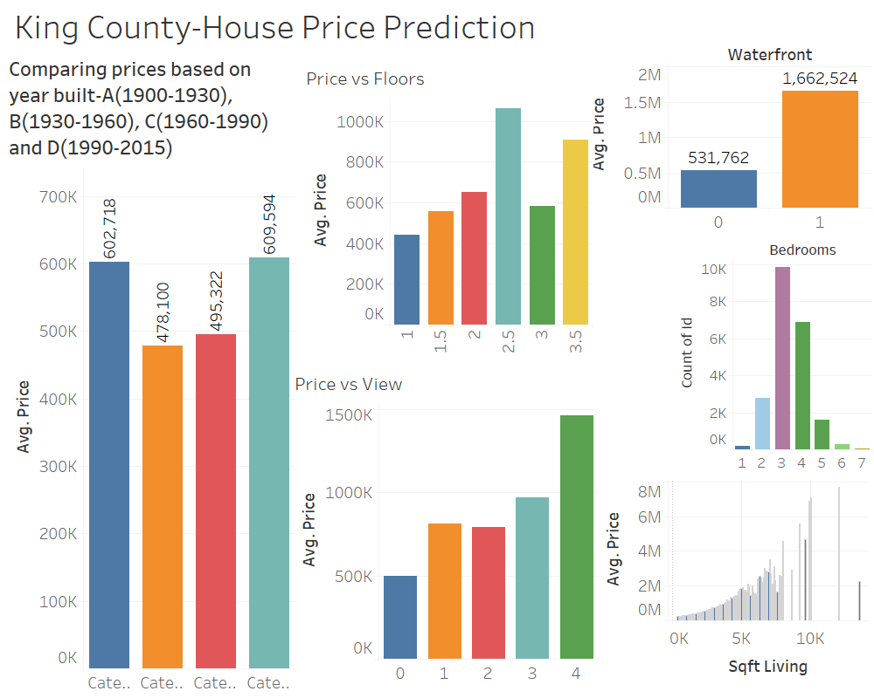
Data Overview

Slide 6
Data Pipeline
Data Source
Data Processing
Linear regression
Improving model by
removing non- significant features
Visualize Results

Slide 7
Data Transformation
Dropped: id, date, lat, long, sqft_above (multicolinearity)
Imported: Distance to city center
Binned:
Year renovated (Yes, No),
basement size (Yes, No),
Grade (average, above average),
Floors (one, more than one)

Slide 8
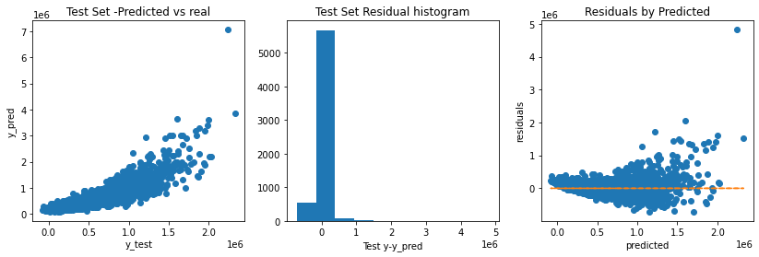
Model Results
 | R2_test | R2_train | Adj_R2
model 1 | 0.7554379531895128 | 0.7696525976580786 | 0.7526178911506988
model 2 | 0.7541199555529359 | 0.7693343591901028 | 0.751363452812498

Slide 9
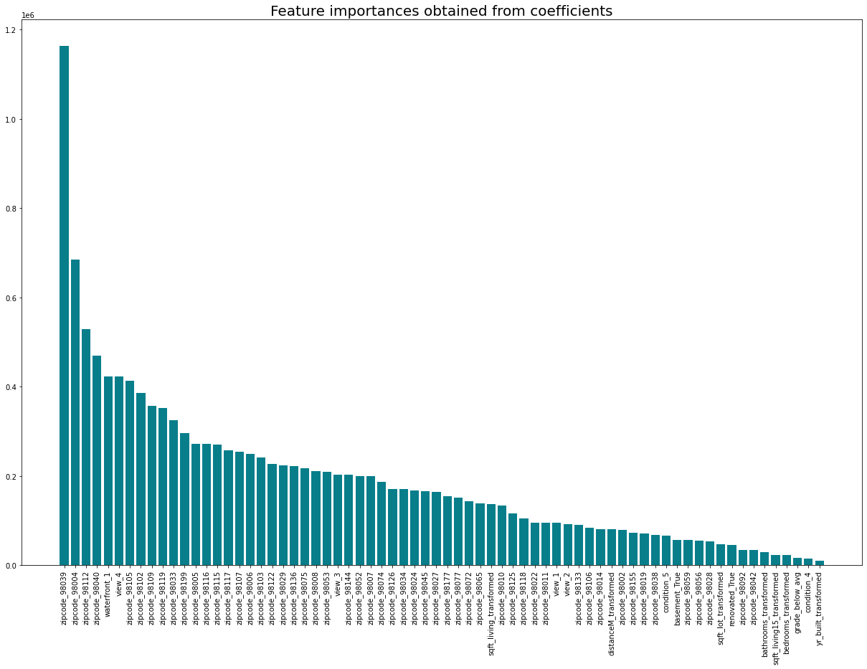

Slide 10
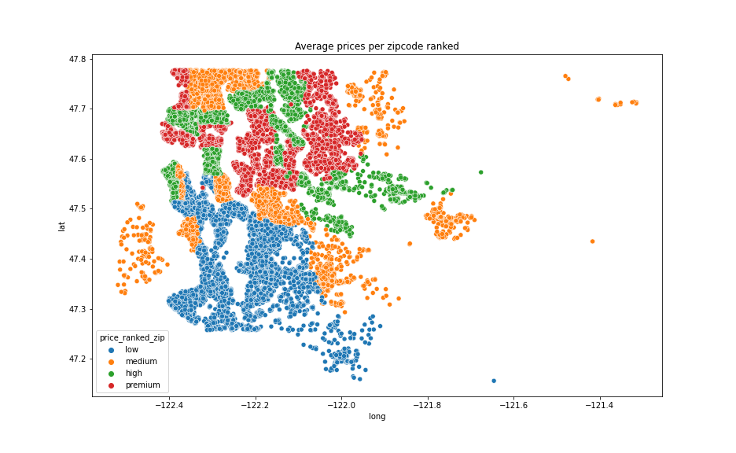
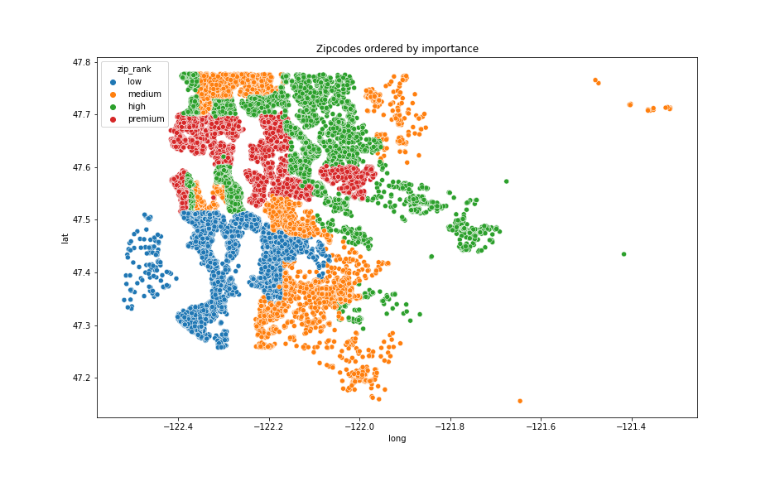
Is my neighbourhood overpriced?
Zipcode most important predictor
Zoning of zipcodes
Define market value of your house
Interesting for:
Real estate companies
Investors (private and commerical)
City planers

Slide 11
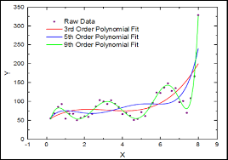
Outlook:
Conclusion
Location (zipcode, distance to center, view, waterfront) define price
Attributes of size are significant but with a smaller influence
Apply Polynomial regression
Apply model on dataset of different cities and areas
Exclude location effect

Slide 12
Thank You!

Slide 13
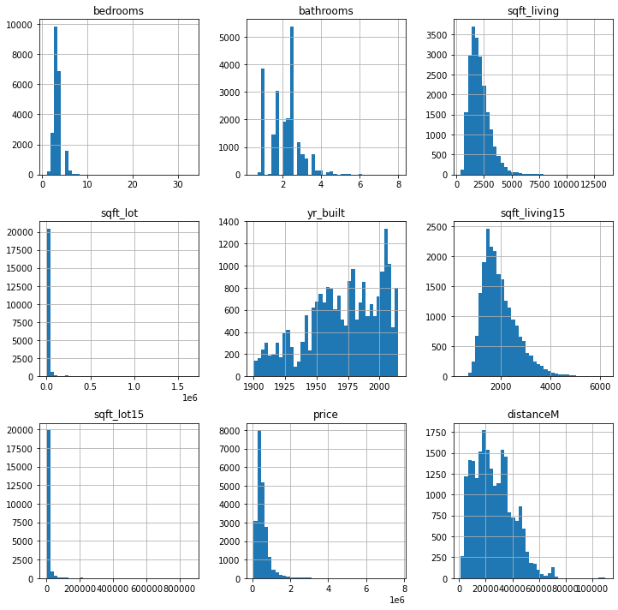
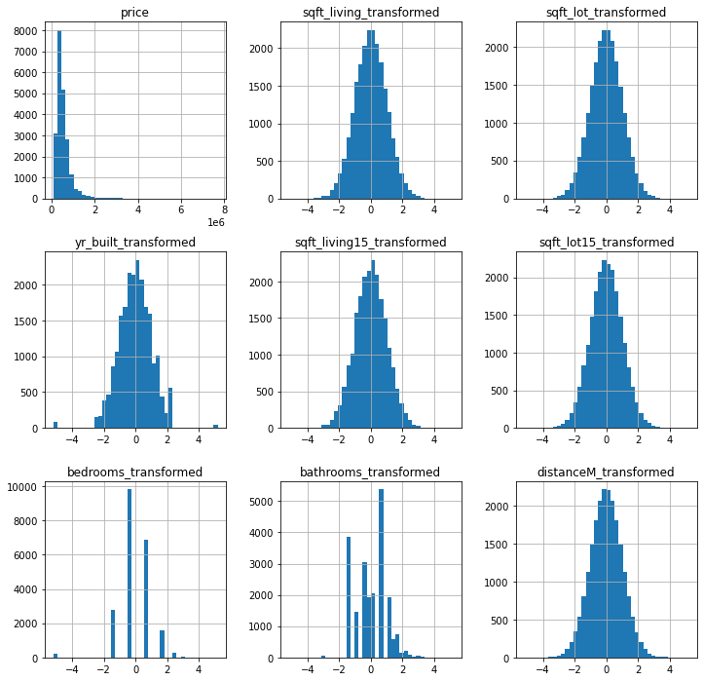
Before and After Modelling-Histograms

Slide 14
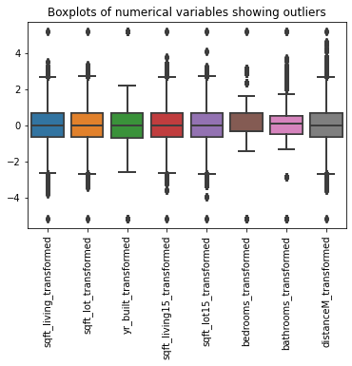
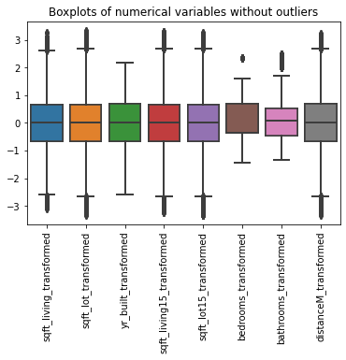
Removing Outliers

Slide 15
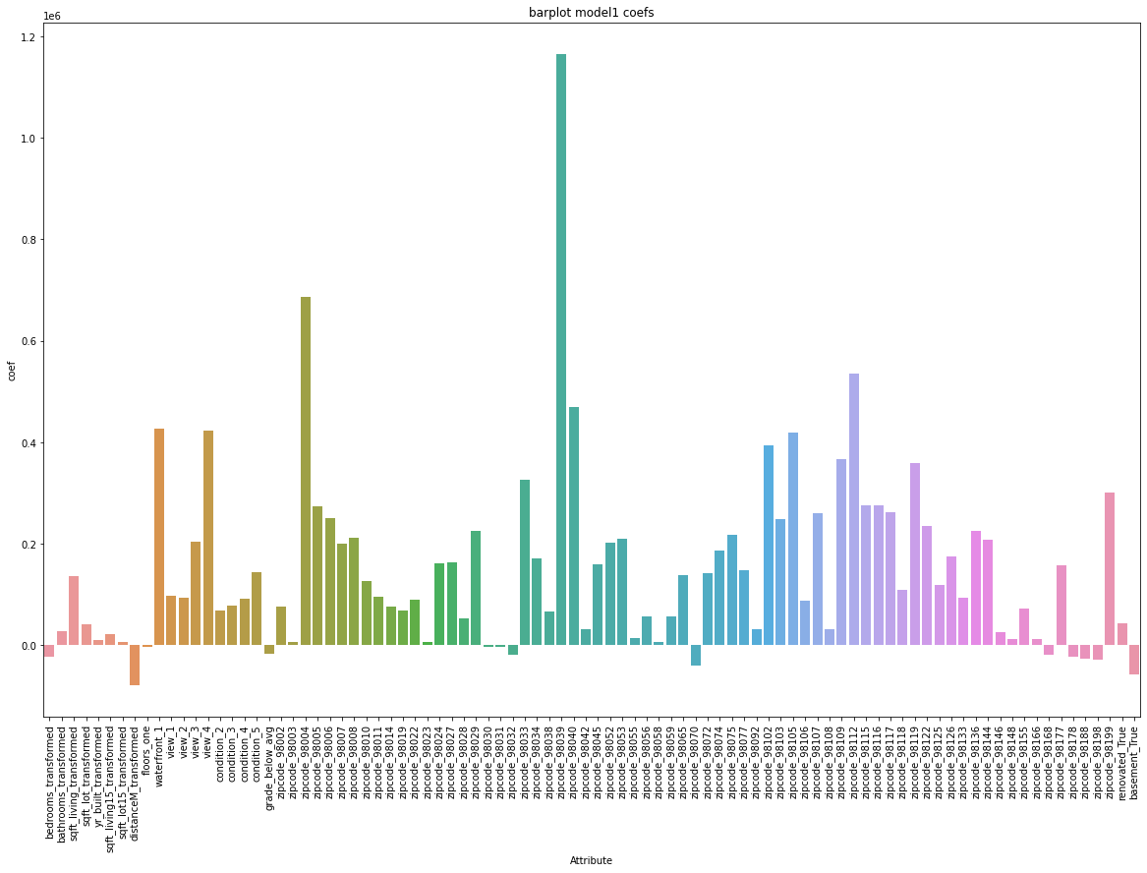

Slide 16
Thank You!

